Slide 1



LIFE: EE4HORECA
Presentation on Work Package 5 2ⁿᵈ and 3ʳᵈ October 2023, Brussels

Slide 2
“Co-funded by the European Union. Views and opinions expressed are however those of the author(s) only and do not necessarily reflect those of the European Union or
CINEA. Neither the European Union nor the granting authority can be held responsible for them”.
2

Slide 3

Work Package 5 – Awareness Raising / Capacity Building
Duration: M02 to M34
Workpackage leader: CCI Spain
Workpackage co-leader: CCI Terrassa
Participants:
Eurochambers
European Cold Storage and Logistics Association
CCI France
Chambre de Commerce et d'Industrie Nice Cote D'azur
Unione Regionale delle Camere di Commercio Industria, Artigianato e Agricoltura del Veneto
Fondazione Fenice Onlus
Universita degli Studi di Brescia
Energieinstitut der Wirtschaft Gmbh
SEnerCon GmbH
Latvijas Tirdzniecibas un Rupniecibas

Slide 4
Work Package 5 – Awareness Raising / Capacity Building
Objetives:
Mobilize all HORECA value chain players in participating countries.
Deepen cooperation among stakeholders, including big companies, SMEs, start-ups, and innovative SMEs.
Reinforce cross-border collaboration to enhance resilience to energy transition risks & Strenghten EU companies’ competitiveness through training and capacity building.
Boost the market uptake of energy efficiency measures, renewables, and heat pumps among EU companies.
Consequently, each partner should play the role in the respective country /region:
To develop sensitization activities to raise awareness, and to identify the key players in the HORECA value chain in the region per country.
Collaborate as expected in WP2 and WP3, since the results of these 2 WPs will become inputs for the training modules.
Participate actively in the organization of round tables and focus groups to comply with the living lab methodology.
Select SMEs for the training of the project and provide guidance to SMEs to implement new energy efficiency measures.

Slide 5
Work Package 5 – Awareness Raising / Capacity Building
WP5 Tasks:
    T.5.1. Preliminary Phase: Organisation of the ToT (Training of Trainers)
    T.5.2. First Phase: Organisation of Working-groups using the living-lab methodology
    T.5.3. Second Phase: Organisation of Training activities
Tasks’ approach:
Preliminary Phase → Training of Trainers (ToT) by EIW, Austria.
1st Phase → Roundtables and working groups in Germany, France, Italy, Spain, and Latvia.
2nd Phase → Tailored training for companies via webinars or workshops on-site in France, Italy, Spain and Latvia.

Slide 6
Work Package 5 – Awareness Raising / Capacity Building
WP5 Deliverables:
          D.5.1. Final report compiling the main recommendations produced by the working group in the 5 countries, including the conclusions about main challenges of the value chain in each region, and additional good practices.
          D.5.2. A Final report with the relation of number of total participants in training webinars in the project, identified by country, agendas, list of participants, presentations used by each country.
DUE DATE: M14
OCT 2024
DUE DATE: M36 - AUG 2026

Slide 7
Work Package 5 – Awareness Raising / Capacity Building
WP5 Timeline:
 | M2 | M3 | M4 | M5 | M6 | M7 | M8 | M9 | M10 | M18 | M34
Task | Oct. 23 | Nov. 23 | Dec. 23 | Jan. 24 | Feb.24 | Mar. 24 | Apr. 24 | May. 24 | Jun. 24 | Feb. 25 | Jun. 26
[To be completed by info of ToT]
Connection |  |  | 15/12/2023
Reflection & Analysis Co-creation ↔ Discurssion
Evaluation & Recommendations |  |  |  |  |  |  | 31/05/2024
Transnational Round Table |  |  |  |  |  |  |  |  | Last week Jun24/First week Jul24
Organization of training activites

Slide 8
Work Package 5 – Awareness Raising / Capacity Building
WP5 KPIs:
420 companies involved in the exploration of energy collaborations.
520 staff trained, having developed their skills, knowledge, know-how, and awareness on the role of sustainable value chains.
Spain | 100 SMEs trained; 120 staff trained
France | 120 SMEs trained; 130 staff trained
Italy | 100 SMEs trained; 120 staff trained
Latvia | 100 SMEs trained; 150 staff trained

Slide 9
T.5.1. Preliminary Phase: Organinsation of the ToT (Training of Trainers)
Presented by Energy Institute for Business (EIW, Austria) and Eurochambers (ECH, Belgium).

Slide 10

T.5.2. 1st Phase: Organisation of Working-groups using the living- lab methodology.
Living lab concept
CO-CREATION
EXPERIMENTATION
EVALUATION
EXPLORATION
STAKEHOLDERS

Slide 11
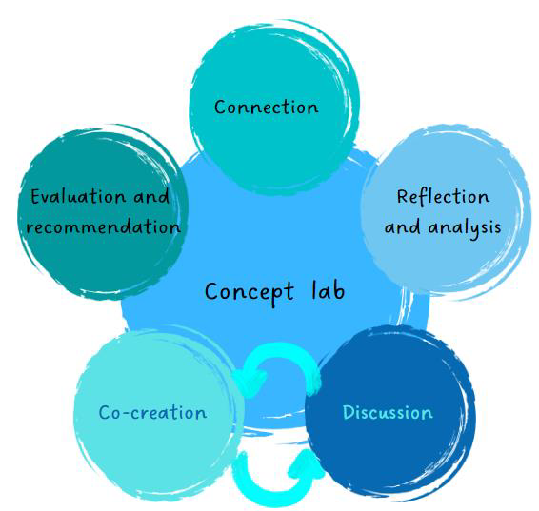
T.5.2. 1st Phase: Organisation of Working-groups using the living- lab methodology.
EE4SME Living Lab – what & how
Germany
France
Italy
Spain
Latvia
Connection: Creation of working groups
1 Working Group / country
25 participants/Group
Profile participants: SMEs, PA, BSOs,
Clusters, Large Companies, etc.
At least 20 SMEs
Reflection & Analysis / Co-creation ↔ Discussion
At least 3 meetings online meetings or in presence/roundtables per country:
    Inputs from WP2
    Challenges
    Good Practices
Evaluation & Recommendations:
→Analysis of the WP3- Analysis of the Integrated Economic Model produced in Month 10/June 24??
→ Document with the recommendations to be transferred to WP3 in June/July 2024 to be presented during:
TRANSNATIONAL ROUND TABLE

Slide 12
T.5.2. 1st Phase: Organisation of Working-groups using the living- lab methodology.
EE4SME Living Lab – Gantt

Slide 13
T.5.3. 2nd Phase: Organisation of Training Activities
Training Activities: Module contents:
Module 1: Basics of Energy Efficiency in the HORECA value chain.
Module 2: Good and best practices identified by WP2 and by Working groups in the project countries.
Module 3: Business Models identified and designed in WP3 of the project.
Module 4: Monitoring tools available in IMPAWATT platform to gain better efficient energy management practices.
Module 5: Support and Funding to gain energy efficiency in the HORECA value chain companies in the region.

Slide 14
T.5.3. 2nd Phase: Organisation of Training activities
Organization:
The training modules will be organised based on WP2 and WP3 outputs.
Format: online webinars / on-site workshops.- (Duration: 10-15 h in total per country).
Each partner will be responsible for the delivery of the seminars in their respective countries.
2 or more training cycles are advised to meet the expected targets.
Language of presentations: English (to be translated by partners into their respective languages if necessary).
Participating SMEs may select the modules they are most interested in attending.
All training materials will be available on the national Impawatt
platforms

Slide 15
Thank you for your attention!

