Slide 1

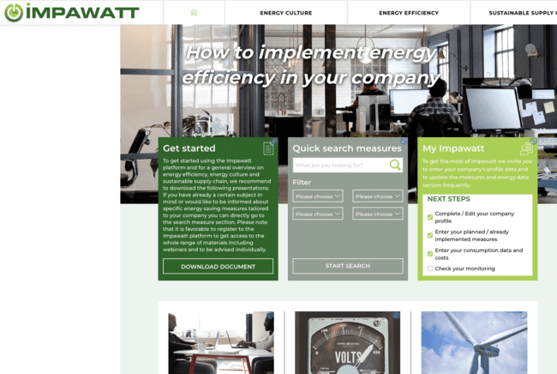

Impawatt –
How it works
Claudia Julius
Senercon

Slide 2
Impawatt at a glance
Knowledge and e-learning platform on Energy Efficiency for companies including monitoring section
Developed during the Horizon 2020 project IMPAWATT
Tested and applied by 189 companies of all sectors
Will be improved and further developed during Life project EE4SME
Will be further developed for the HORECA supply chain within the Life project EE4HORECA project

Slide 3
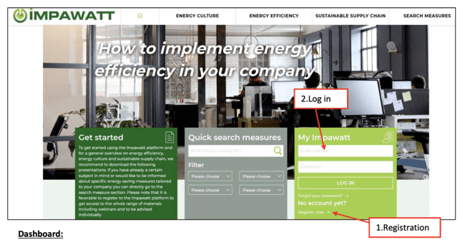

Registration on the Impawatt Landing Page
On the home page click on « Register now » under « My Impawatt » and follow the instructions. You will receive an email with a link to confirm your registration. Once confirmed, you can log into the platform.

Slide 4








Impawatt themes
Energy efficiency
Energy culture
Sustainable supply chain
Energy management
Plants (pumps, motors, fans, compressed air, process heat)
Building (heating and cooling, envelope, ventilation, BMS)
Lighting systems
Mobility
Renewable energies
Enable companies to motivate their employees for behavioural changes towards increases energy efficiency
Life cycle analysis
Guidelines for life cycle costs
Use of sustainability indicators
Environmental labelling

Slide 5
Impawatt content
Tailored content for registered companies
More than 200 content elements
Measure descriptions
PowerPoint presentations
Factsheets (best practices)
Tools (self-assessment tool, funding guidance, EE behavior survey, checklists, quiz, data collection sheet)

Slide 6
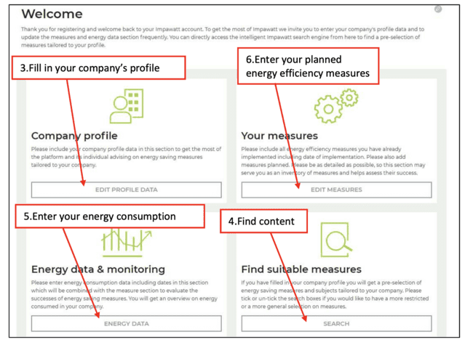
Dashboard to chose different Impawatt features

Slide 7
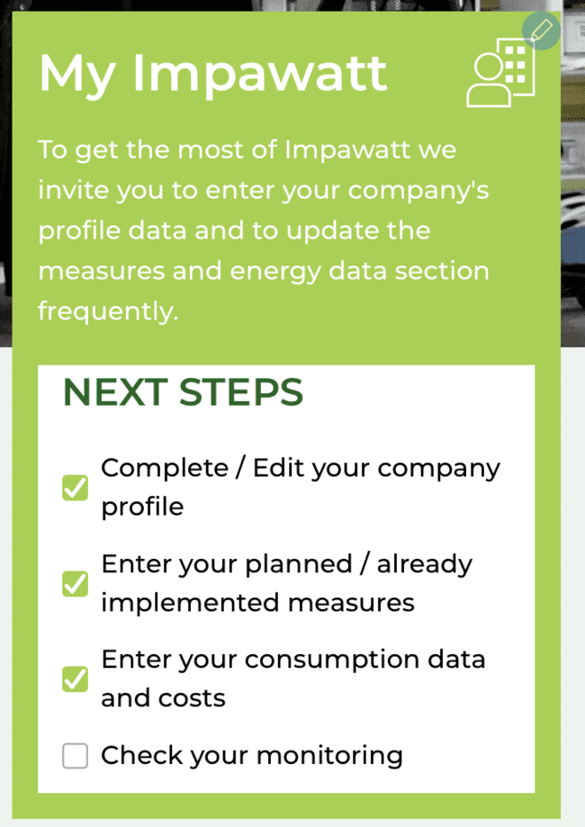
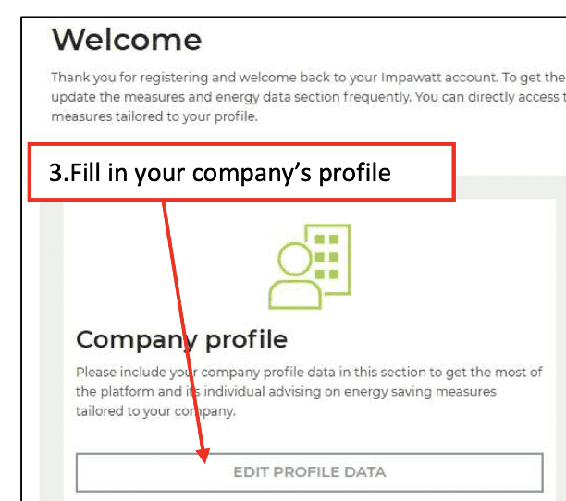
Filling in the company‘s profile
You can fill in company data either through the homepage. My Impawatt box
« Complete/Edit company profile » or via « company profile » on the dashboard

Slide 8
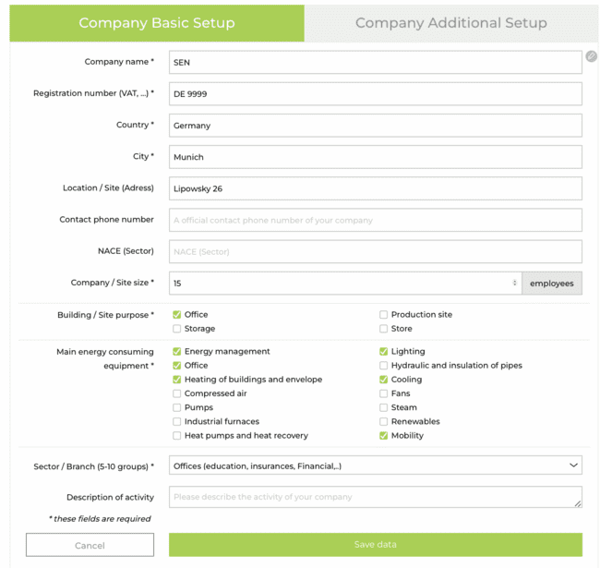
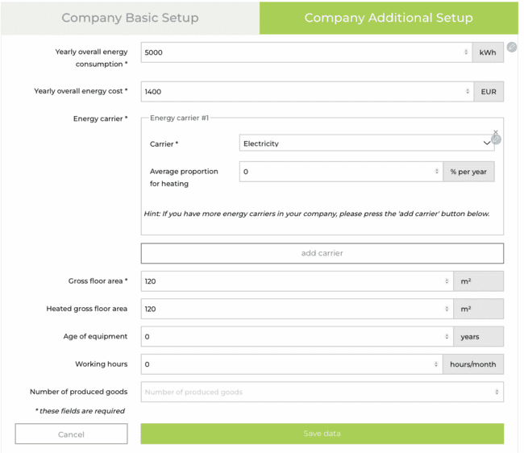
Filling in the company‘s profile
You can fill in company data either through the homepage. My Impawatt box
« Complete/Edit company profile » or via « company profile » on the dashboard

Slide 9
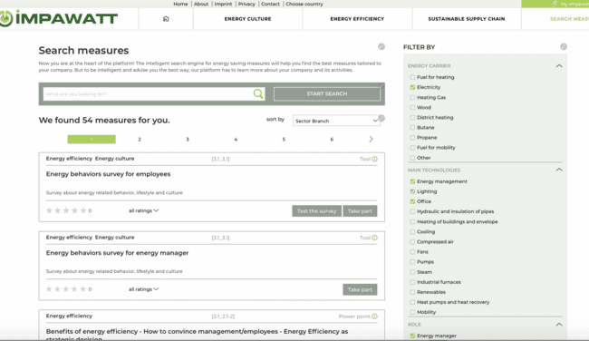
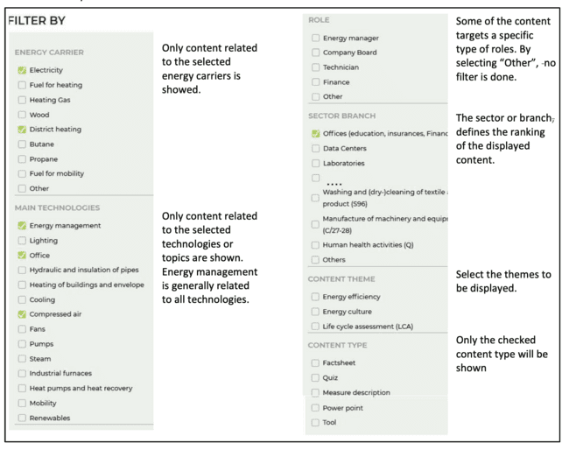
Finding content
Pre-selection according to profile
Selection according to different criteria
Free text search

Slide 10
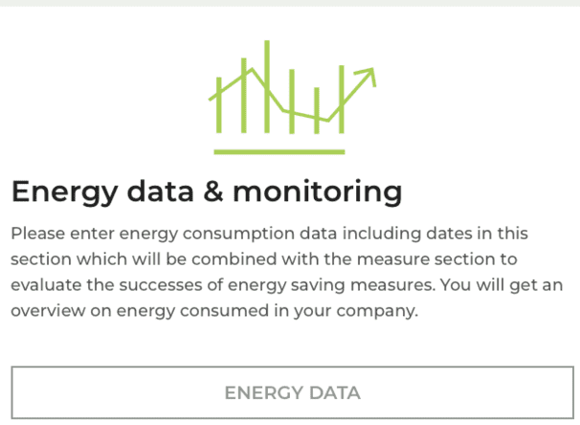
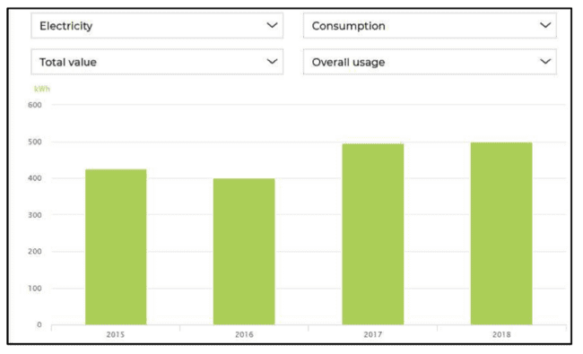
Energy data & monitoring
Consumption
Cost
According to energy carrier
Annunal or specific consumption
Part for heating or total consumption

Slide 11
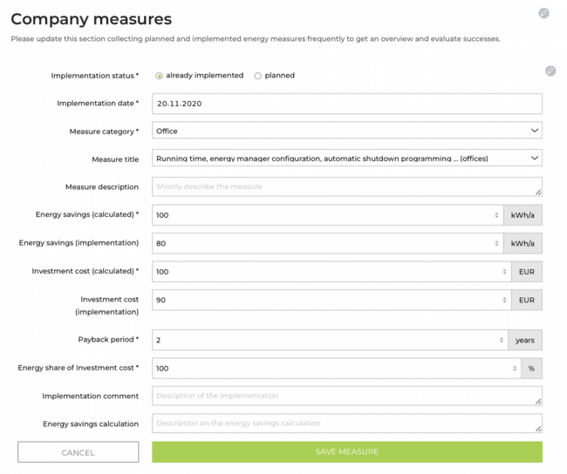
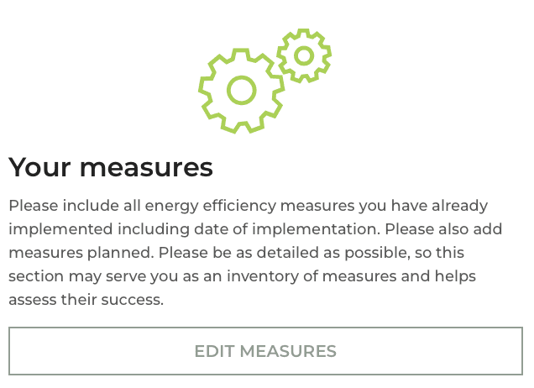
Company measures
Energy efficiency plan
Planned and implemented measures

Slide 12
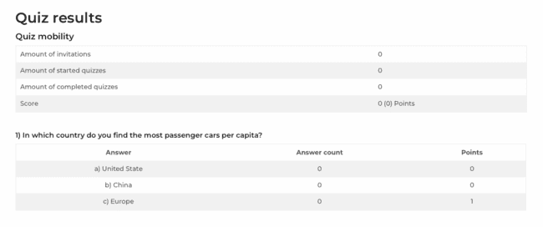
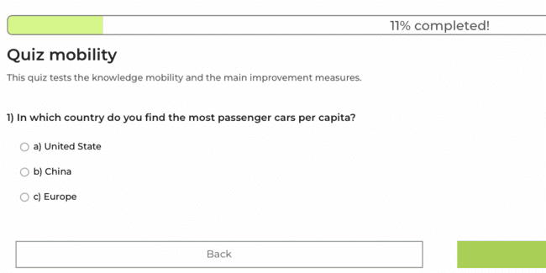
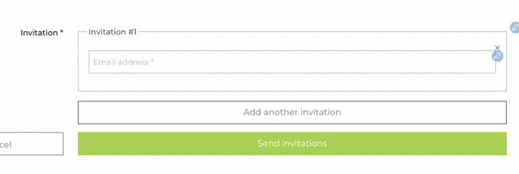
Quiz section
Test
Invite employees
Show results

Slide 13
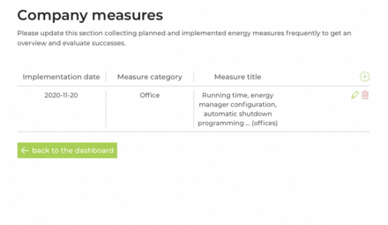
Content section and filter engine
Platform sections
Energy data monitoring
Energy efficiency measure monitoring
Consumption, cost according to energy carrier, annunal or specific consumption
Part for heating or total consumption

Slide 14
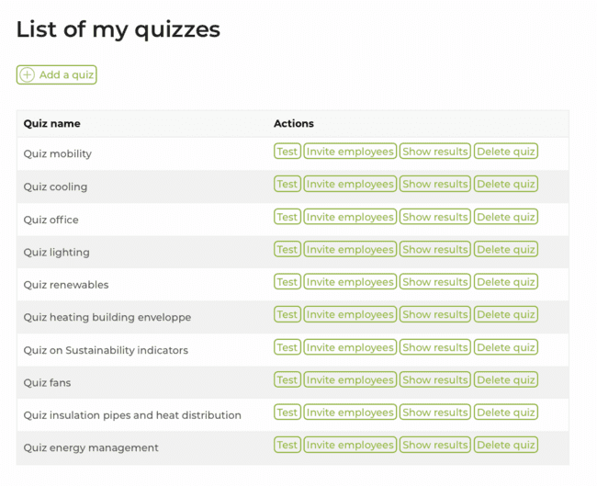
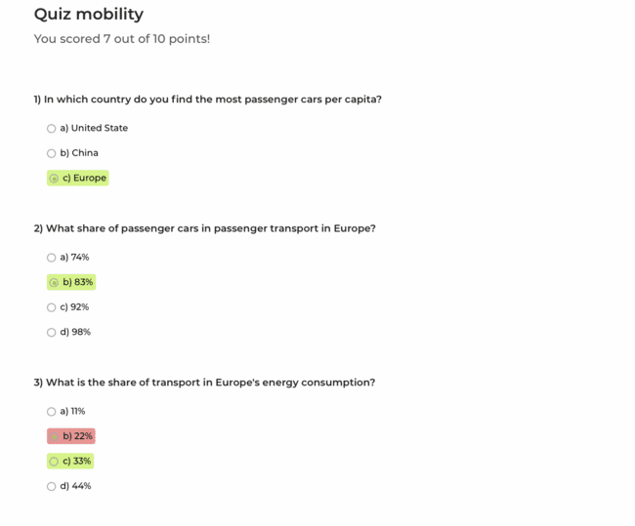
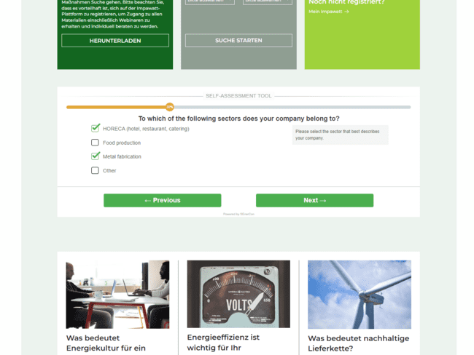
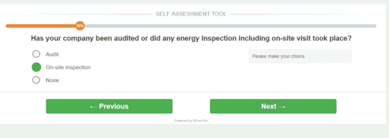
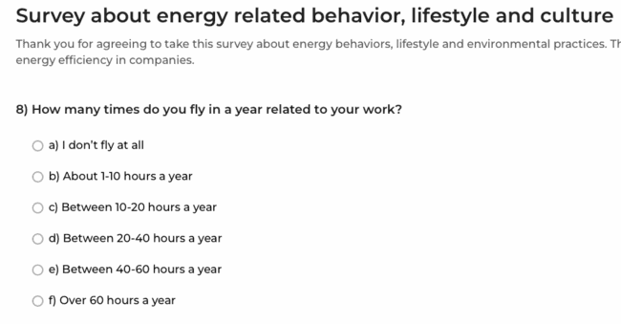
Quiz section
Interactive Tools
Self-assessment tool
Behavior survey
Funding guidance (coming soon)

Slide 15
Impawatt has different levels of user roles
Administrator: Translation, content management, quizzes, evaluations
Energy advisor: Manages several companies, can be invited
Company: different roles possible: energy manager, technician, CEO…
Employees: can be invited to a quiz

Slide 16
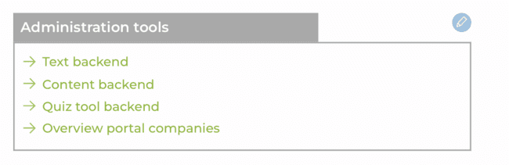
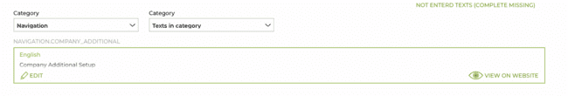
Impawatt has different levels of user roles
Administrator: Translation, content management, evaluations
Translation backend:

Slide 17
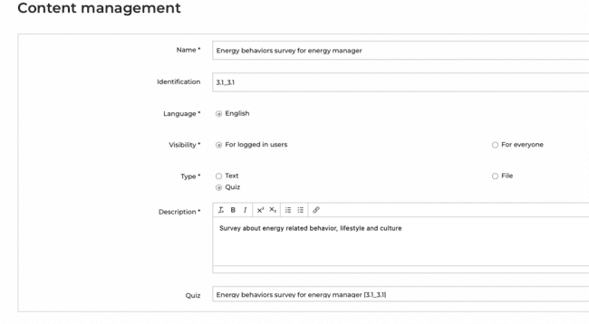
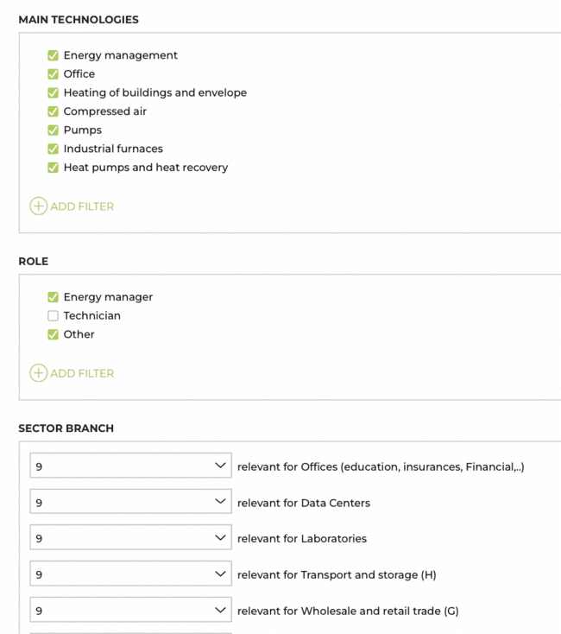
Administrator: Content Backend

Slide 18
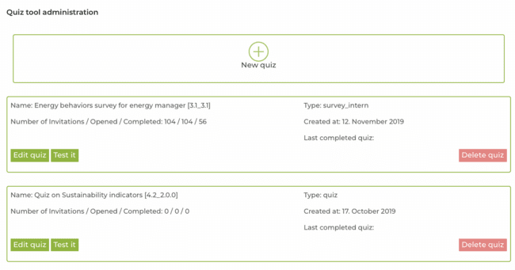
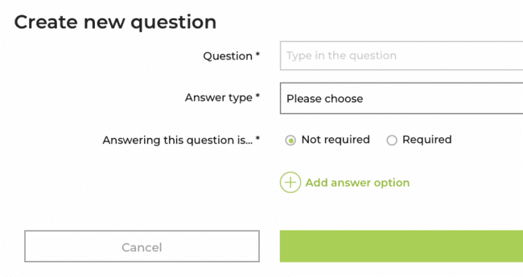
Administrator: Quiz Backend

Slide 19
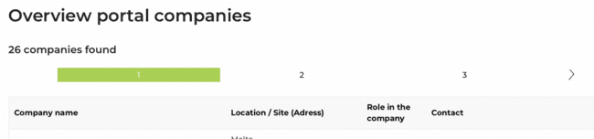
Administrator: Evaluation Overview portal companies

Slide 20

Thank you for your attention!
Claudia.Julius@senercon.de
Senercon
Co-funded by the European Union. Views and opinions expressed are however those of the author(s) only and do not necessarily reflect those of the European Union or CINEA. Neither the European Union nor the granting authority can be held responsible for them.
Grant agreement n° 101076459 LIFE21-CET-AUDITS

Slide 21
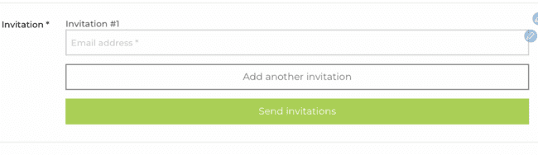
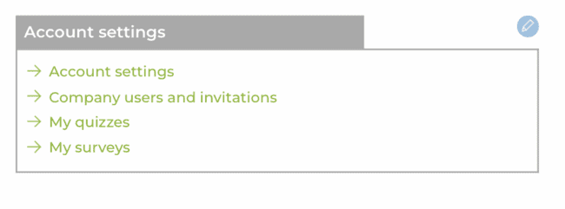
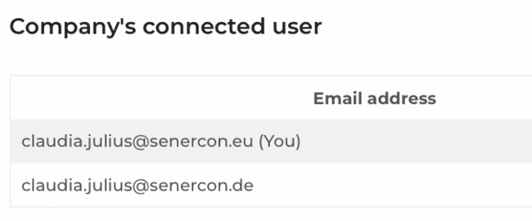
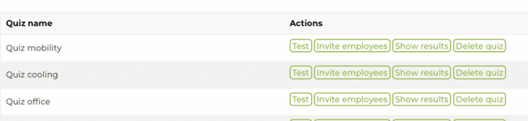
Account settings
Invitation to share account
Invitation
Quizzes

