Slide 1
LIFE: EE4HORECA:Energy Efficiency in HORECA Sector
WP2 AND WP3 IN RELATION WITH WP5

Slide 2
EE4HORECA PROJECT: KEY DATA
Participating Countries: Austria, Belgium, France, Germany, Italy, Latvia and Spain
Duration: 36 months
Implementation period: 1st of September 2023- 31 August 2026
Objective: Enhance the skills of energy technicians and top management within a company to better understand the multiple benefits achievable from collaborative approaches between large and small companies across the value chain within the HoReCa sector.
Key Performance Indicators (KPIs) and Impact:
Train 520 staff, allowing for improved skills/ knowledge/ awareness/ know-how on the role of sustainable value chains in promoting the clean energy transition of the HoReCa sector.
420 companies will be involved in the exploration of energy collaborations.
10.000 further stakeholders will be reached and informed about the initiative and tools.
3,9 GWh/year Primary energy savings triggered by the project during its lifetime.
2,7 (GWh/year) Final energy savings triggered by the project during its lifetime.
2,1 Renewable energy generation triggered by the project (GWh/year) during its lifetime.
1,92 MEuro Investments in sustainable energy triggered by the project (cumulative, million Euro) during its lifetime; around additional 3 million Euros within 5 years after the end of the project.
1159 tons CO2eq/year saved.
2

Slide 3
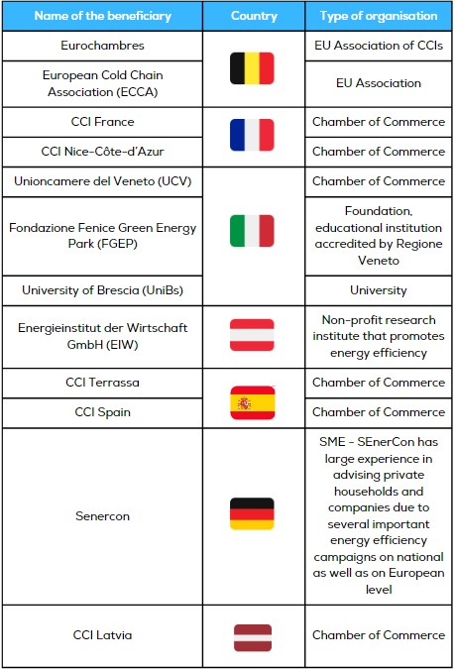
The consortium
2

Slide 4
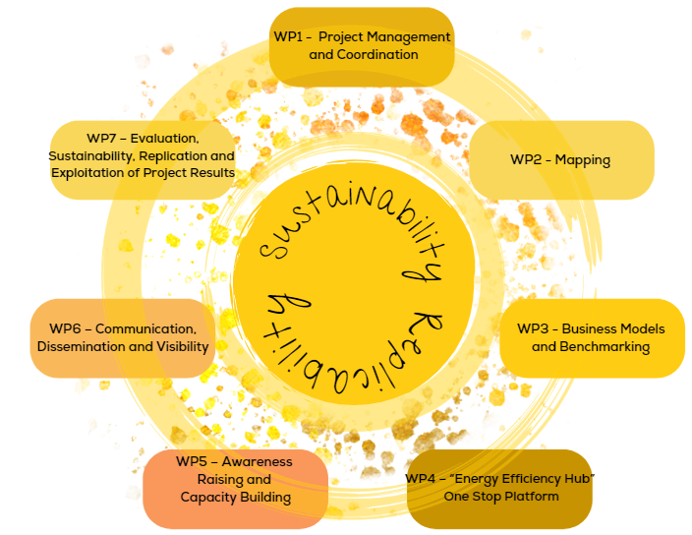
The WPs
Working Groups participation
2

Slide 5
Work Package 2: Mapping Study
Duration: M02 to M12
WP2 leader: Fondazione Fenice Green Energy Park in collaboration with
Participants: 5 HORECA stakeholders from Austria, France, Italy, Latvia and Spain.
Aim:
Measure the energetic consumption of the companies that participate in the project (large and SME companies)
Create a list of effective energetic practices that can be replicate in other companies of the sector for energy efficiency
Recommend adequate good practices to replicate across the business model of the HORECA sector

Slide 6
Work Package 2: Mapping Study
Contents:
Create the cross-border working group of 25 companies across 5 countries that will contribute to mapping the best practices of the HORECA value chain
Identifying energy consumption across the HORECA value chain mapping the direct and indirect energy processes through analysis with a focus on energy consumption for identifying the key points in which major savings of energy may be feasible.
Identify the best energy efficient transferable practices across the value chain and validate them through interviews with different actors of the HORECA sector
Publication of the identified energy efficiency measures though a set of viable recommendations for improving energy performance of HORECA SMEs.

Slide 7
Work Package 3: Business Models and Benchmarks
Duration: M01 to M12
WP3 leader: University of Brescia
Participants: 3 UNIBIS (Italy), ESCLA (Belgium), EIW (Austria)
Aim:
Evaluate the supply chain of the HORECA sector and define best practices to improve their sustainability
Analyze the life cycle of the HORECA sector and develop an integrated economic model that take in account considerations on the non energy benefits impacts
Using the data directly gathered from the supply chain to evaluate the untapped potential of energy efficiency and renewable at each step of the value chain.

Slide 8
Work Package 3: Business Models and Benchmarks
Contents:
The evaluation of the supply chain of the HORECA sector can be broken down in several parts, among which the main ones are transportation, processing and handling. Once the resources flows are mapped, the best practices will be identified.
Developing an integrated economic model that takes in account all relevant impacts on the economic, environmental and social dimensions and that analyze the whole process from materials production, processing, distribution, use and waste.
Defining the data collection methodology, creating a database to investigate the energy performance of the supply chain

Slide 9
WP5: Awareness Raising and Training Modules.
T.5.2. 1st Phase: Organisation of National Working-groups using the living- lab methodology.
Duration: M02 -- M34
CO-CREATION
EXPERIMENTATION
EVALUATION
EXPLORATION
Living lab concept
STAKEHOLDERS

Slide 10
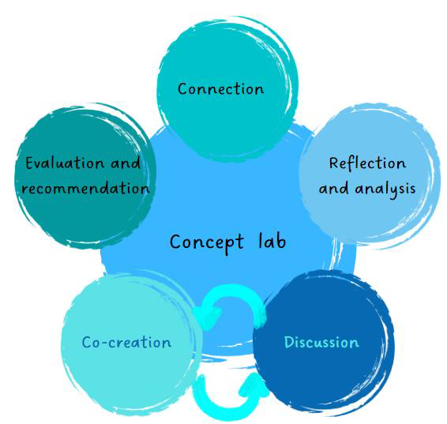
T.5.2. 1st Phase: Organisation of National Working-groups using the living- lab methodology.
EE4HoReCa Living Lab – what & how
Germany
France
Italy
Spain
Latvia
Connection: Creation of working groups
1 Working Group / country
25 participants/Group
Profile participants: SMEs, PA, BSO,…
At least 20 SMEs
Reflection & Analysis / Co-creation ↔ Discussion
At least 3 meetings online meetings or in presence/roundtables per country:
Inputs from WP2
Challenges
Good Practices
Evaluation & Recommendations:
→Analysis of the WP3- Analysis of the Integrated Economic Model produced in Month 10- June 2024
→ Document with the recommendations to be transferred to WP3 in July 2024 to be presented during:
TRANSNATIONAL ROUND TABLE

Slide 11
Summarizing: activities WP2-WP3-WP5

Slide 12
T.5.3. 2nd Phase: Organisation of Training Activities
Duration: M14 -- M32
Training Activities: Module contents:
Module 1: Basics of Energy Efficiency in the HORECA value chain.
Module 2: Good and best practices identified by WP2 and by Working groups in the project countries
Module 3: Business Models identified and designed in WP3 of the project.
Module 4: Monitoring tools available in IMPAWATT platform to gain better efficient energy management practices.
Module 5: Support and Funding to gain energy efficiency in the HORECA value chain companies in the region.

Slide 13
T.5.3. 2nd Phase: Organisation of Training activities
Organization:
The training modules will be organised based on WP2 and WP3 outputs.
Format: online webinars (2 hours aprox. each module) / on-site workshops.
Each partner will be responsible for the delivery of the seminars in their respective countries.
Language of presentations: English (to be translated by partners into their respective languages if necessary).
Participating companies may select the modules they are most interested in attending.
All training materials will be available on the national Impawatt platform

Slide 14
EE4HORECA: Participation in Working Group
25 partipants from 5 Countries: Austria, France, Italy, Latvia and Spain.
4 online meetings
Working on: Mapping Study / Business Model
Participation on Living Lab
Language of presentations: English – with the collaboration of partners
Spanish participants:
Asociación Hosteleros Málaga
https://mahos.es/
Valladolid
https://www.abadia-retuerta.com/
Gran Canaria
https://www.lopesan.com/en/
Sant Cugat del Vallès
https://canametller.com/en/
Catalunya
https://www.viena.es/ca/
Hotel Don Candido
https://canametller.com/en/

Slide 15
Thank you for your attention!

